Slide 1
Elements of Fiction

Slide 2
The Elements
Plot
Characters
Setting
Theme
Point of View

Slide 3
Plot
Sequence of events
Exposition
Rising Action
Climax
Falling Action
Resolution
Contains conflicts
External Conflict
Person vs. Person
Person vs. Society
Person vs. Nature
Internal Conflict
Person vs. Self

Slide 4
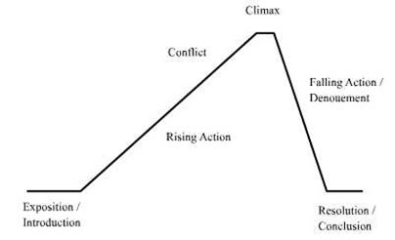

Slide 5
Characters
Protagonist
Antagonist
Static—do not change during the story
Dynamic—undergo a change due to an event happening to them
Flat—stereotypical; shallow; one or two personality traits; not fully developed
Round—realistic; have many different personality traits; fully developed

Slide 6
Setting
Time
Place
When and Where

Slide 7
Theme
What is theme?
NOT a summary of events!!

Slide 8
Point of View
Who is telling the story?
How do we know what happens?
Does the character simply tell us?
1st person
3rd Omniscient: know almost everything
3rd Limited: “limited” is key word

Slide 9
Science Fiction
Outrageous characters, situations, and settings.
Future
Advances in technology
Different political and social systems

