Slide 1
Elements of Fiction

Slide 2
The Elements
Plot
Characters
Setting
Theme
Point of View

Slide 3
Plot
Sequence of events
Exposition
Rising Action
Climax
Falling Action
Resolution
Contains conflicts
External Conflict
Person vs. Person
Person vs. Society
Person vs. Nature
Internal Conflict
Person vs. Self

Slide 4
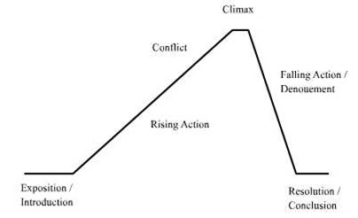

Slide 5
Characters
Protagonist
Antagonist
Static—do not change during the story
Dynamic—undergo a change due to an event happening to them
Flat—stereotypical; shallow; one or two personality traits; not fully developed
Round—realistic; have many different personality traits; fully developed

Slide 6
Characters
Stock: instantly recognizable (stereotype)
Geek, policeman, stern librarian
Often a flat character
Archetype: ideal, universally recognized model personality (epitome)
Superhero, villan, etc
Can be protagonist OR antagonist
Symbolizes a deeper, universal meaning

Slide 7
On a sheet of paper….
Put these characters into the correct group of either stock character or archetype:
Jock
Spoiled rich kid
Wise old man
Avenger
Ditzy girl
Mother figure
Geek
Trickster

Slide 8
Setting
Time
Place
When and Where

Slide 9
Theme
What is theme?
NOT a summary of events!!

Slide 10
Point of View
Who is telling the story?
How do we know what happens?
Does the character simply tell us?
1st person
3rd Omniscient: know almost everything
3rd Limited: “limited” is key word

Slide 11
The Gift of the Magi
Journal:
What is something you have that does not have a big $ value but that means a lot to you?
Would you ever give up that item? In what situations?

Slide 12
Irony
Verbal
Dramatic
Situational
Be looking for irony in the story!!!
Why use irony?
Dramatic=suspenseful
Verbal or Situational=Humorous
Helps to communicate the theme to the reader

